Slide 1

Most popular tech book - 2025

Slide 2
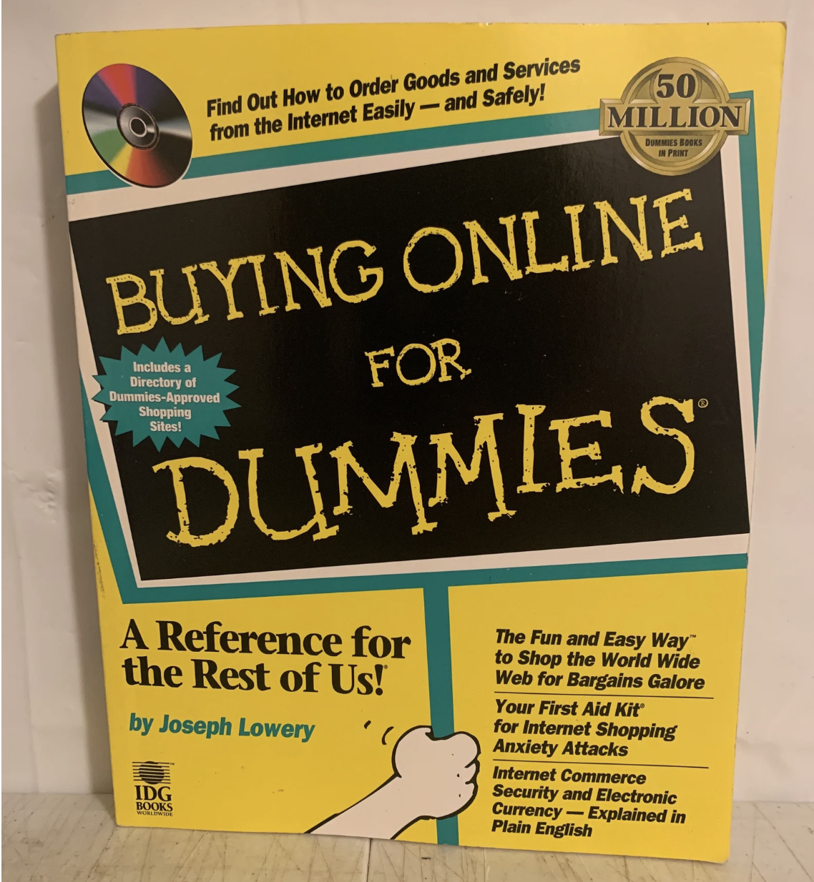
Most popular book in 1998

Slide 3
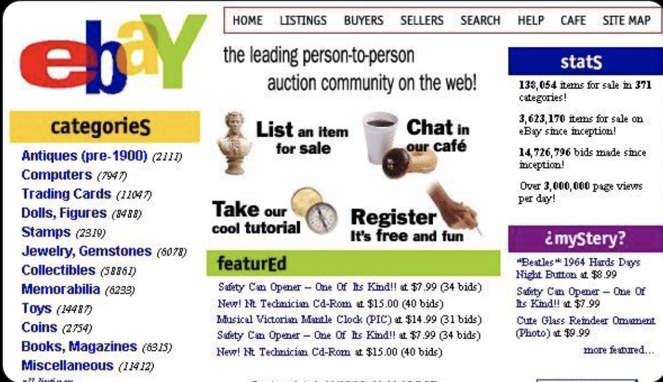
Where did you shop in 1998?

Slide 4
What did online shopping look like?
Website Design
Text, Text, and Text and More Text
Low resolution images that take forever to load
Poor navigation (imagine no search)
Checkout
Credit cards not secure
Offline payments
Phone orders
Fulfilment
7-10 days
No real time updates
What’s free shipping?
Notes:
Digital Transformation is happening everywhere – be it websites, checkout, fulfilment and every other aspect, if you are not digitizing in this day and world you might as well go back being in stone age. What else was happening in 1998?
A company called Fieldlink was established which was later named as Confinity - What did they sell? They sold security software for handheld devices. With a failed business model they pivoted to launching a electronic payment system called PayPal. This was the first example of how PayPal turned the tables on digitization, were they the first one, no, however they focused on a big problem making peer to peer payments simple and that is what made them standout and still be the number one peer to peer app in the US.

Slide 5
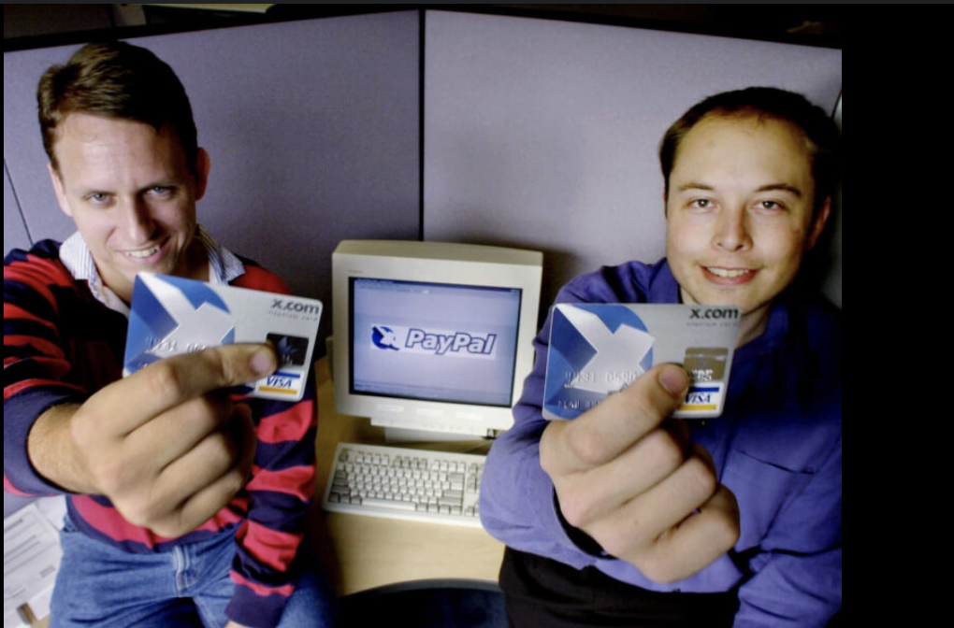
1999 - Enter Online Payments – The real x.com
Notes:
B/W 1999 and 2001 x.com doubled down on online money transfer business and named it PayPal.

Slide 6
2000?
……………………………………………………………………
Notes:
What was the dot com bubble? Investors put a lot of money in companies with .com in their name, many of them did not have strong business models, spent on Marketing and went public with ZERO profits. Revolutionize commerce but didn’t truly happen. In the giants that survived the bubble – Google, Amazon, eBay, PayPal was one amongst them, why because it solved an important problem and had a strong business model.

Slide 7
Phase 1 – Disruption in Traditional Payments
Seamless payment provider – no need to write checks, send money orders etc.
Supported both sellers and buyers
Easy to use for e-commerce and P2P transactions
Safe & Secure

Slide 8

Happy or Rocky Alliance
Notes:
By 2002 PayPal was used on 70% of eBay transactions, most of which were auctions. eBay acquired PayPal because it was the number 1 used payment method and was better than their home grown Bill Point system. In the beginning it was all about powering eBay payments, auctions and expanding with eBay.
After solidifying eBay payments, PayPal Merchant Services was started to provide payment solutions to e-commerce merchants outside eBay auctions. (Expand on Merchant Services).
As part of providing Merchant Services PayPal expanded its network to provide:
Online payments for retailers and mobile apps
Acquired new companies mainly in the form of Braintree and the beloved Venmo?
While PayPal was busy with eBay and expanding its availability across merchants they were lagging in providing services in a mobile first ecosystem.

Slide 9

It was Inevitable!
Notes:
By 2013 activist investors like Carl Icahn believe that PayPal would benefit from splitting with eBay given eBay’s focus on Marketplace and PayPal’s focus on providing payments services. Eventually eBay and PayPal split but PayPal remained the primary payment method on eBay

Slide 10
Phase 2 – Digitization by Acquisition
Date | Acquisition
Sep 2013 | Braintree & Venmo
May 2015 | Paydiant
Jun 2015 | Xoom
May 2018 | iZettle
Jun 2018 | Hyperwallet
Jun 2018 | Simility
Nov 2019 | Honey
Notes:
The first acquisition was Braintree and the app we all use today. (Any guesses). In the era of mobile first payments solutions which were on the raise with the entry of Uber, Airbnb and others needed payment providers that were built with mobile first technology and ease. PayPal realized its lack of this technology and acquired Braintree which was already powering payments for these mobile first eco-systems. It gave PayPal the edge in API modernization as Braintree’s technology was built on strong SDK’s and API suite. In addition to powering mobile payments, Braintree was winning in the developer community which was key to moving away from the image of being a dinosaur. The other reason was the raise of Venmo which was challenging P2P payments which PayPal pioneered. By acquiring Braintree they acquired Venmo which was a acquisition of Braintree itself. _ Mobile first payments was not the only reason an array of payment providers specifically that would make credit/debit card processing simpler and secure were emerging and challenging PayPal. Stripe, Apple Pay, Square. Braintree gave the edge to PayPal in the digital payments era, thereby proving the digitization by acquisition philosophy.
Paydiant – To expand offline/instore offering
Xoom – Remittance market
iZettle – POS for SMB’s and compete with competitors
Hyperwallet – Enhance payout capabilities (Serving Marketplaces and Gig Economy)
Simility – Strengthen fraud and risk management
Honey – Capture shopping journey, leverage rich data, defend against competitors
Before Covid could start PayPal turned into a leader in payment provider services one that had the potential to only grow!

Slide 11

Phase 3 – Powering the NextGen
Notes:
Right when Covid hit two things took the e-commerce sector by storm, one that would stick the other where we are headed. Let’s look at the first one:
Emergence of alternate payment methods. Towards the beginning of Covid PayPal saw an increasing competition by alternate payment methods like Klarna, Afterpay, Affirm that hit the e-commerce space with storm. Talk about Buy Now, Pay Later.
If Buy now pay later offers were here to stay, PayPal also built its strong foothold in the crypto space by supporting the buy, sell and hold of cryptocurrencies which were booming during Covid. Come 2021 PayPal would expand and launch checkout with crypto which was being converted at the time of purchase. In 2023, launched its own stablecoin with the goal of setting them aside from other providers and building for the future.

Slide 12
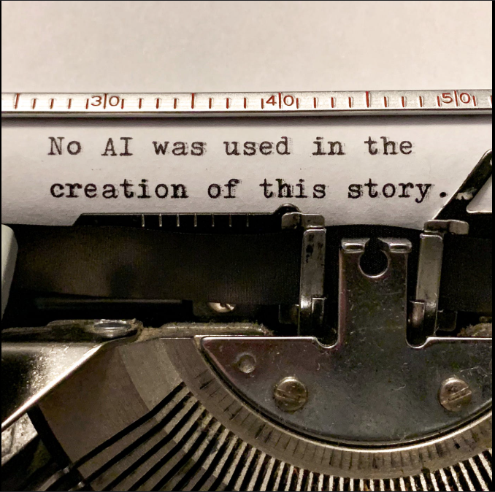
Phase 4 – Agentic Commerce
Be the mind that powers and executes decisions with the same trust and safety it is known for.
Notes:
Agentic Commerce – Where Agents perform the shopping journey and not users, just like using Alexa to place your Amazon orders on steroids.
PayPal has amassed a lot of data, there is so much potential to build uniquely compelling products and AI can help in every shape and perform.

Slide 13
Missed Opportunities
Braintree started as Stripe but never caught up to it, developers love something that is builder friendly.
Late entry into POS and in-store payments.
Super App never took off (impact on China strategy).
Always stayed a FinTech didn’t evolve into other areas.
Competing with commodity (UPI)

